Slide 1
CSE 2207
Numerical Methods

Slide 2
Approximation and Errors in Computing

Slide 3
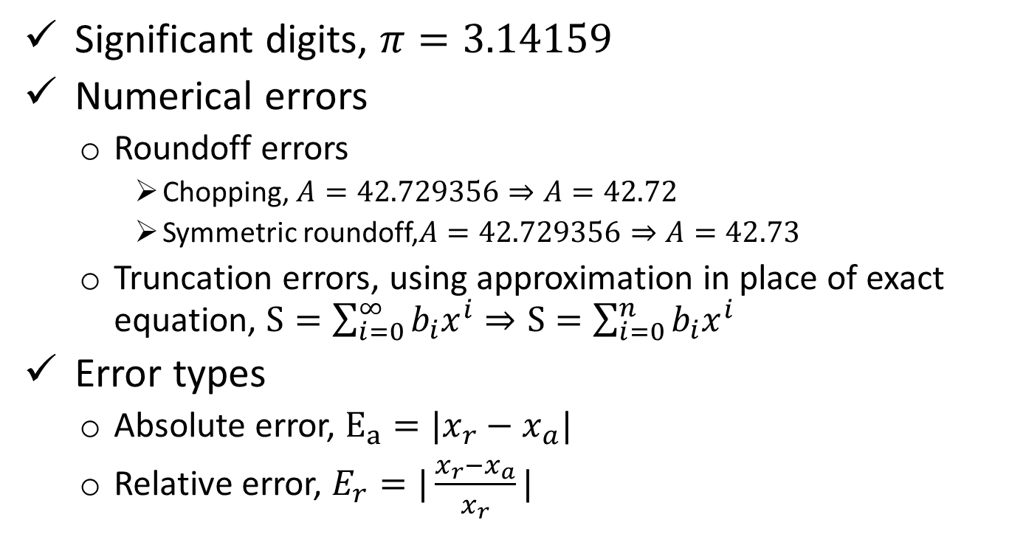
Approximation and Errors in Computing
Significant digits, $π=3.14159$
Numerical errors
Roundoff errors
Chopping, $A=42.729356⇒A=42.72$
Symmetric roundoff,$A=42.729356⇒A=42.73$
Truncation errors, using approximation in place of exact equation, $S=\sum_{i=0}^{∞}{b_{i}x^{i}}⇒S=\sum_{i=0}^{n}{b_{i}x^{i}}$
Error types
Absolute error, $E_{a}=|x_{r}−x_{a}|$
Relative error, $E_{r}=|\frac{x_{r}−x_{a}}{x_{r}}|$

Slide 4
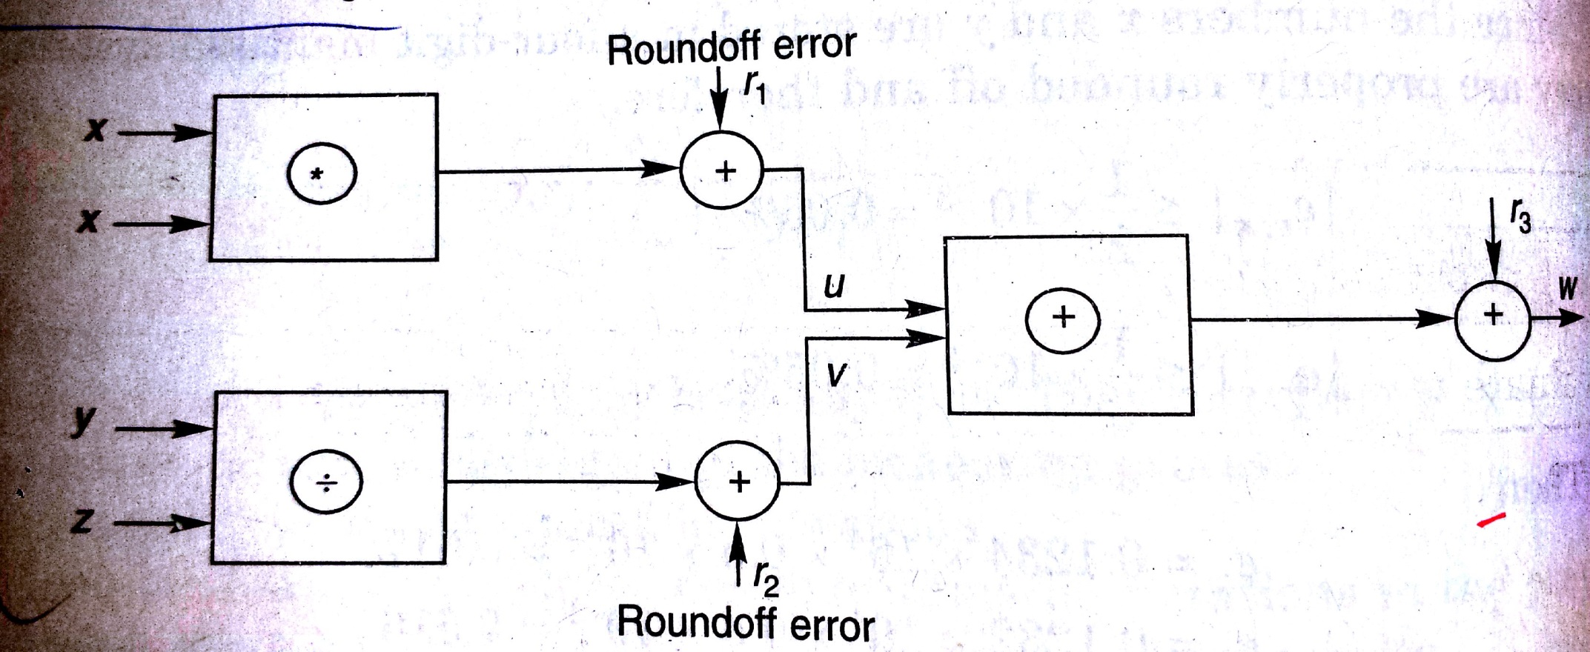

Error Propagation
Error propagation, $W=x^{2}+yz$, every stage is a source of new errors

Slide 5
Approximation and Errors in Computing
Error estimation
Forward error analysis, estimate error bounds considering uncertainties.
Backward error analysis, in what extent the final result satisfies the original result.
Experimental error analysis, involves a series of experiments using different methods, and step sizes
Minimizing the total error
Increase the significant digit
Minimize the number of arithmetic operations
Avoid subtractive calculations
Choose proper initial value

Slide 6
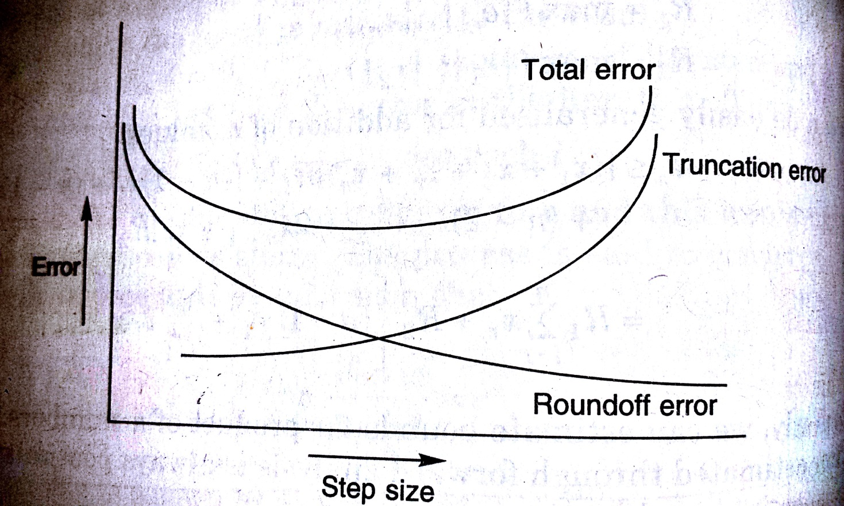
Dependence of error on step size
Increasing step size, reduce the no. of iterations
Hence reduce roundoff error
However increases truncation error
So judiciously choose the step size to minimize the total error

Slide 7
References
1. Numerical Methods by E Balagurusamy
2. Numerical Methods for Engineers by S.C. Chapra, R.P. Canale

